Slide 1
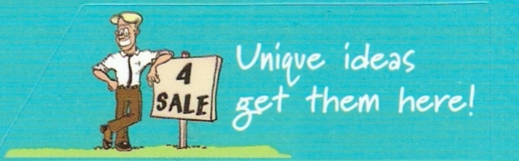
Do Now activity

Slide 2
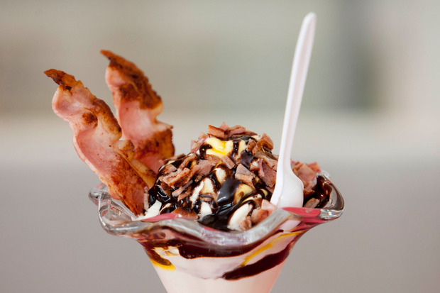
Learning intention :
Over the next three lessons we are going to develop the brief that Burger King gave to their Product Development Team when they developed the Bacon Sundae.
Let’s recap.....

Slide 3

A brief is made up of:
A need or opportunity
An outcome
Specifications ( detailed attributes )
A conceptual statement that communicates what is to be done and why it should be done – by answering the questions who, what, why, when, where and how.

Slide 4
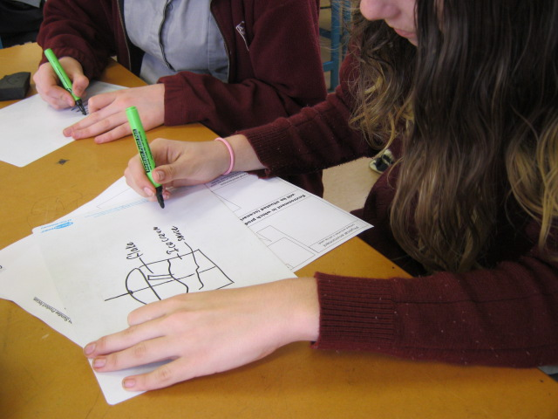
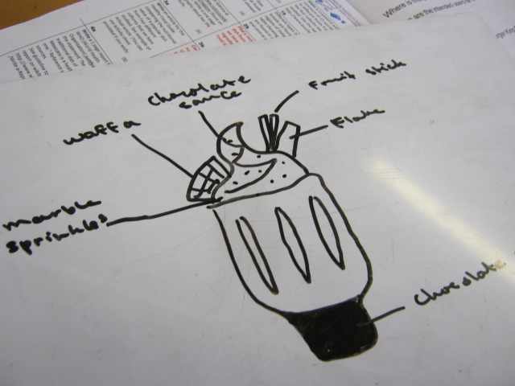
Do now activity on show me boards
Basic Burger King sundae
With substituted ingredients

Slide 5
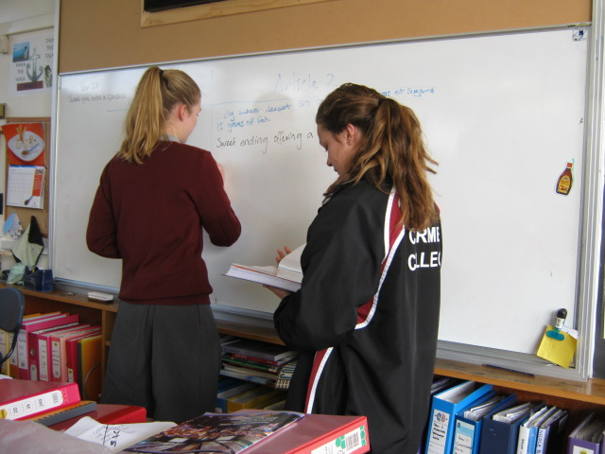
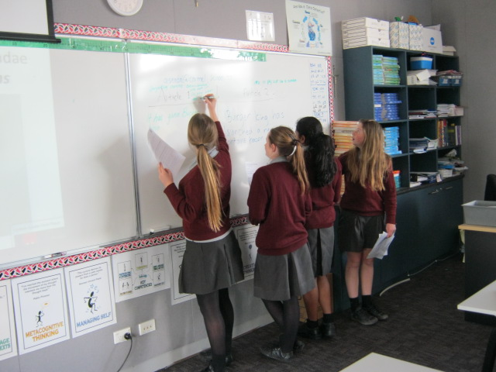
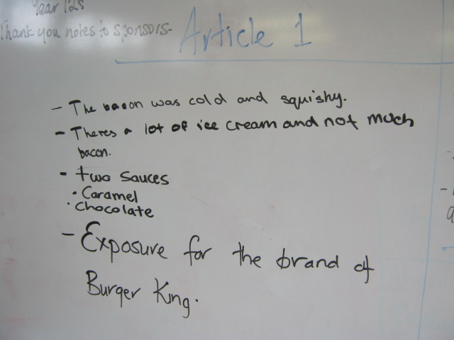
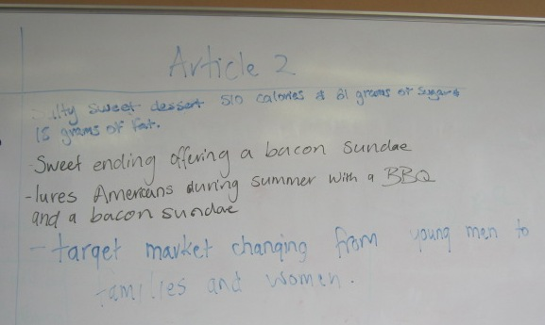
Read two articles and share the information

Slide 6
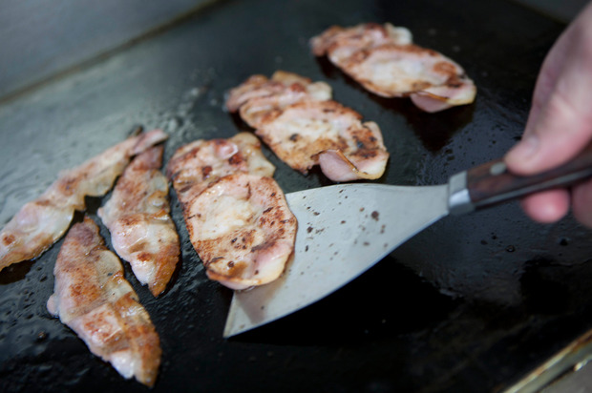
How do you make a bacon sundae? (What materials are needed?)

Slide 7
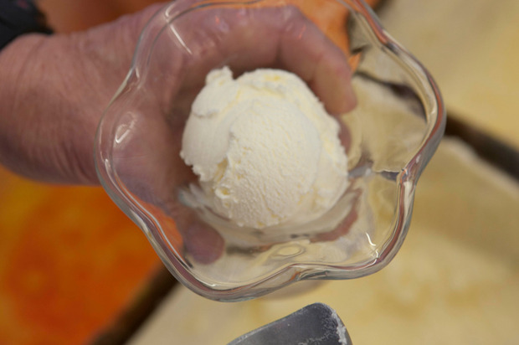
Ice cream

Slide 8
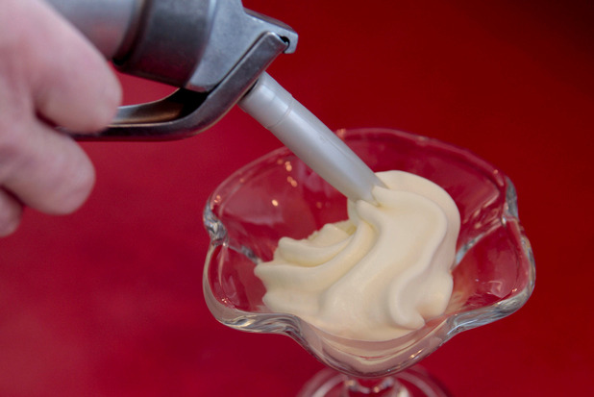
Whipped cream

Slide 9
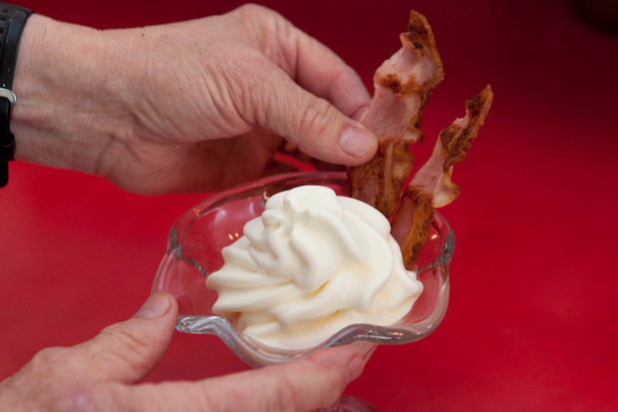
Bacon

Slide 10
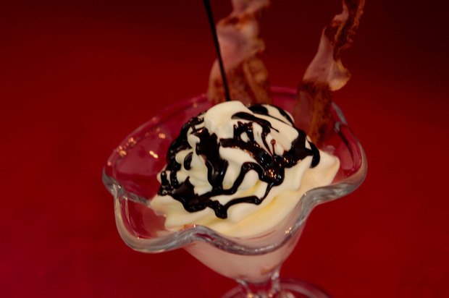
Chocolate and caramel sauce

Slide 11
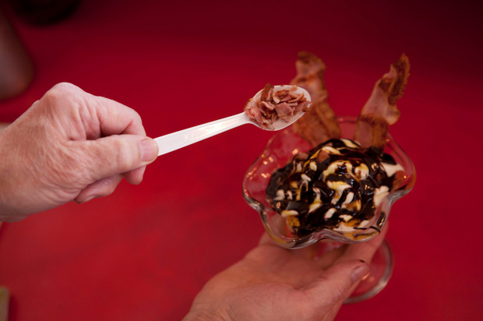
Bacon bits

Slide 13
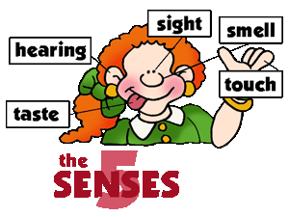
Materials (ingredients) used
Specifications
What performance properties (attributes) will each material have?
  Taste
  Flavour combinations
  Texture
  Temperature
  Visual
  Nutrition

Slide 14
Identify the functional and physical attributes of the Bacon Sundae and highlight them in two different colours.
Functional – how a product performs or “what it can do”
Physical – the product’s appearance or “what it looks like”

Slide 15
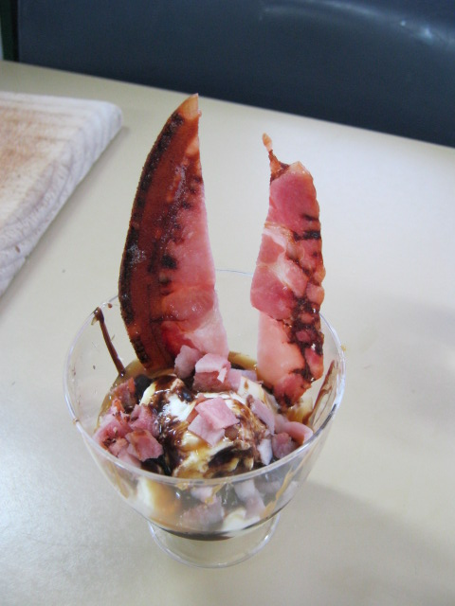
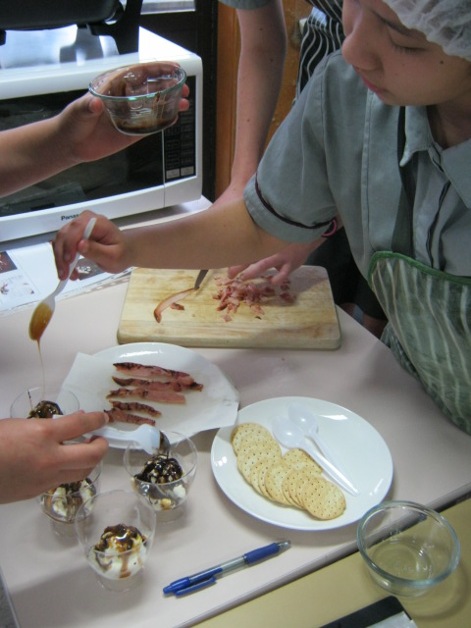
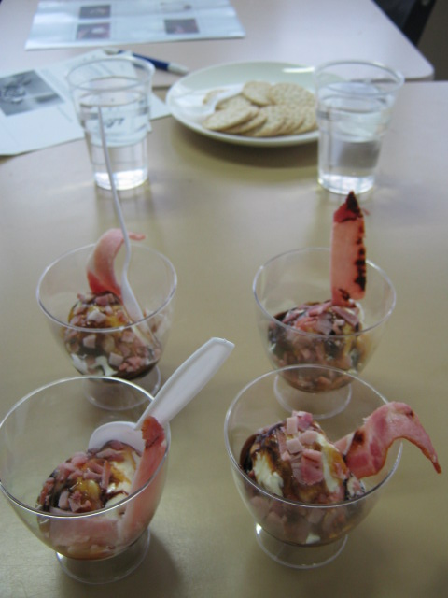
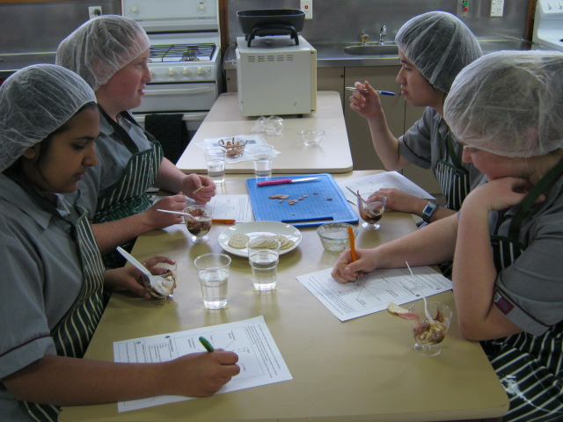
Practical lesson

Slide 16
Sensory Evaluation
Star chart
1. tasty
5
2. crispy
8. Harmonious flavours
4
3
2
1
7. cold
3. soggy
4. greasy
6. sundae-like appearance
5. appetising

Slide 17
Learning intention for today’s lesson:
Finish developing the brief that Burger King gave their Product Development Team

Slide 18

Brief ??????????????
Need or Opportunity ?????
An outcome
Attributes Specifications
Conceptual Statement? who, what, why, when, where and how?

Slide 19
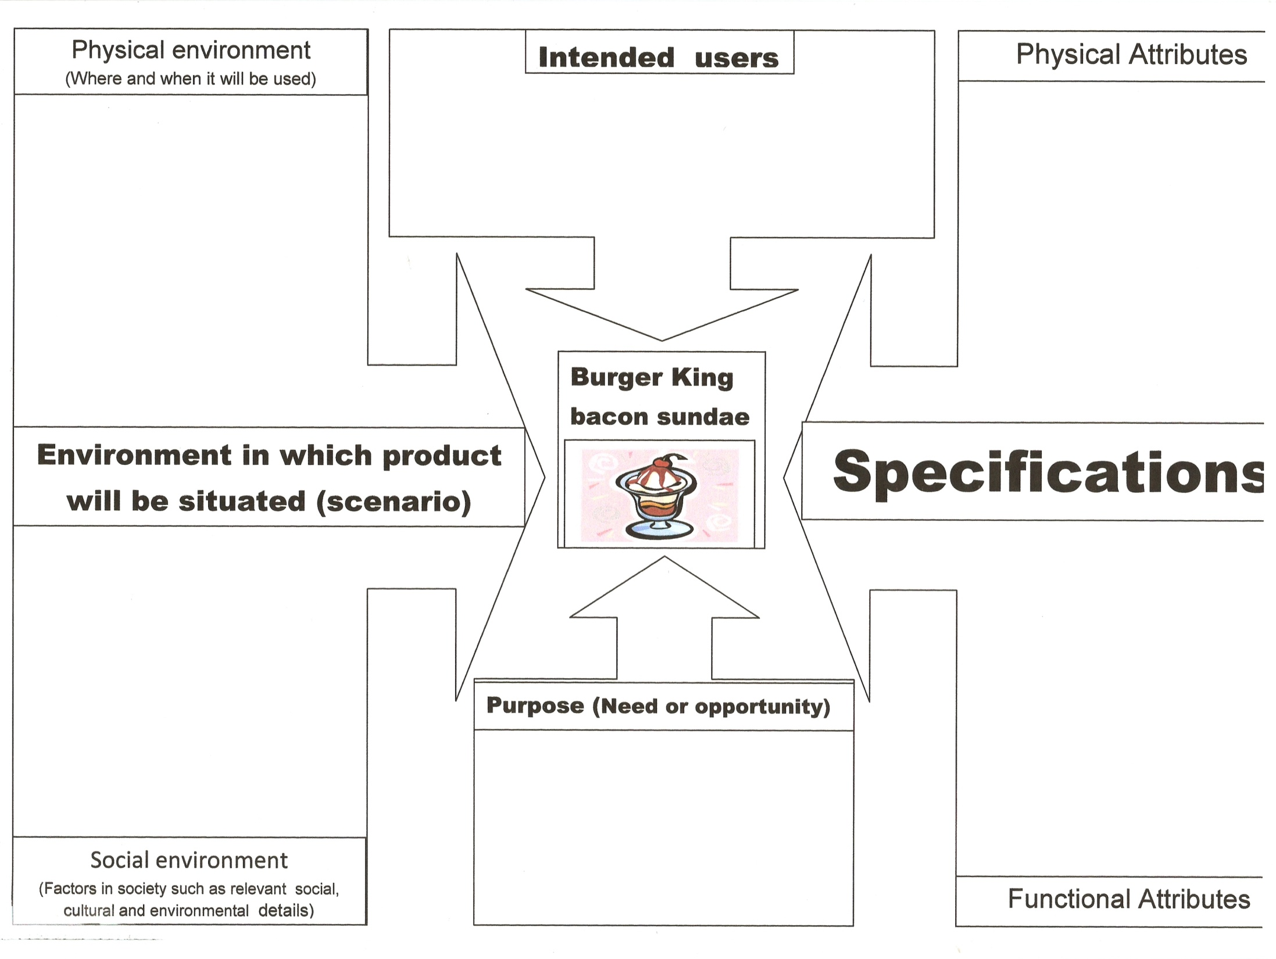
Who?
Where and when?
How?
Conceptual statement
What
Why?

Slide 20
Who
Where and when
Changing from young men to families and women
the product’s appearance or what it ‘looks like’
America
People who liked to try new stuff
June 14 2012
How?
What
Why?
how a product performs or ‘what it can do’

Slide 21
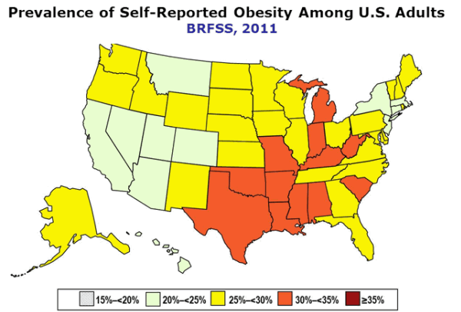
Social environment
http://www.cdc.gov/obesity/data/adult.html

Slide 22
Who
Where and when
Changing from young men to families and women
America
People who liked to try new stuff
June 14 2012
How?
More than 30 % of America’s population is considered obese which shows that they are unhealthy eaters and a product such as this would probably appeal to them
What?
Why?
Going public on the stock exchange so this is a marketing ploy to get the brand talked about

Slide 23
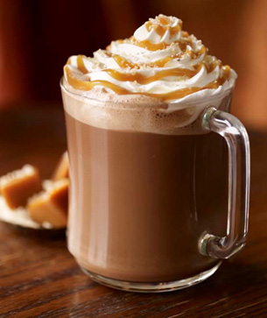
Salted Caramel Mocha
New food trends

Slide 24
Who
Where and when
Changing from young men to families and women
the product’s appearance or what it ‘looks like’
America
People who liked to try new stuff
June 14 2012
How?
More than 30 % of America’s population is considered obese which shows that they are unhealthy eaters and a product such as this would probably appeal to them
What
Why
how a product performs or ‘what it can do’
Going public on the stock exchange
New food trends

Slide 25
Let us write Burger King’s conceptual statement stating what is to be done and why it should be done
Who:
Burger King has asked for a product to be developed for families and women and a summer marketing campaign.
What:
To develop a new sundae. The sundae should be made like a traditional sundae and combine salty and sweet tastes and look good enough to eat and taste amazing.
Why:
Attract the attention of Americans as the company goes public on the stock exchange.
Where and when:
This product needs to be completed by end of May 2012 in America.
How:
Discuss functional and physical attributes,
e.g. the sundae must contain ice cream so that it looks like a sundae.

Slide 26


Do you predict that this product will be a success or a failure?

